Slide 1
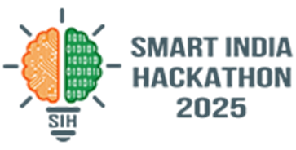
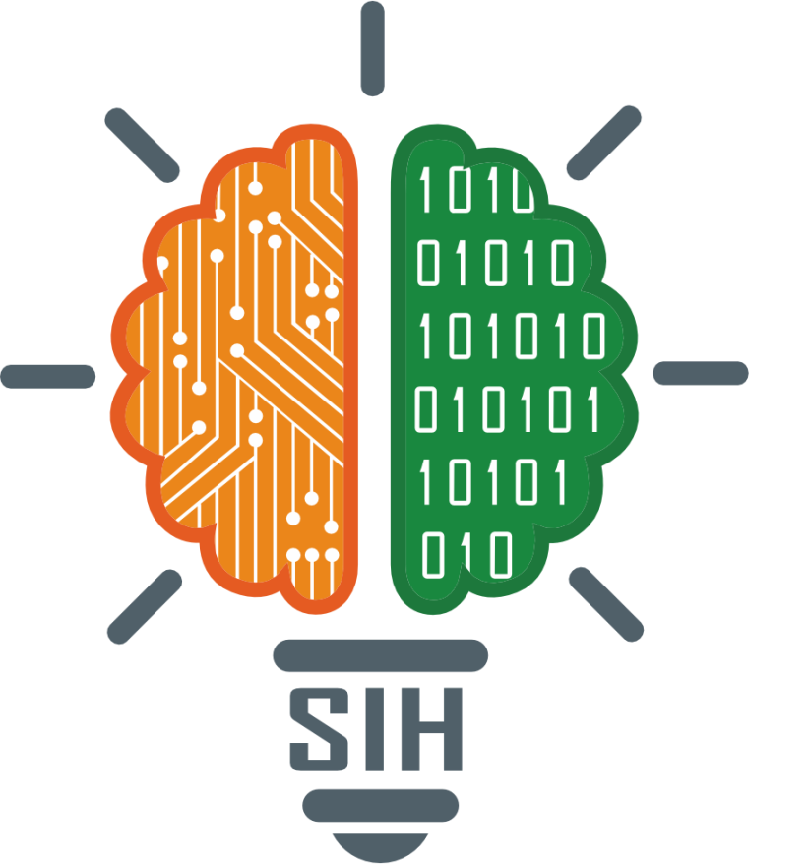
SMART INDIA HACKATHON 2025
Problem Statement ID - SIH 25092
Problem Statement Title - Development of a Digital Mental Health and Psychological Support System for Government of Jammu and Kashmir
Theme - MedTech / BioTech / HealthTech
PS Category - Software
Team ID - 528
Team Name - Team Y.M.I.R.
Team Mentor - Dr. Nitin Jain

Slide 2
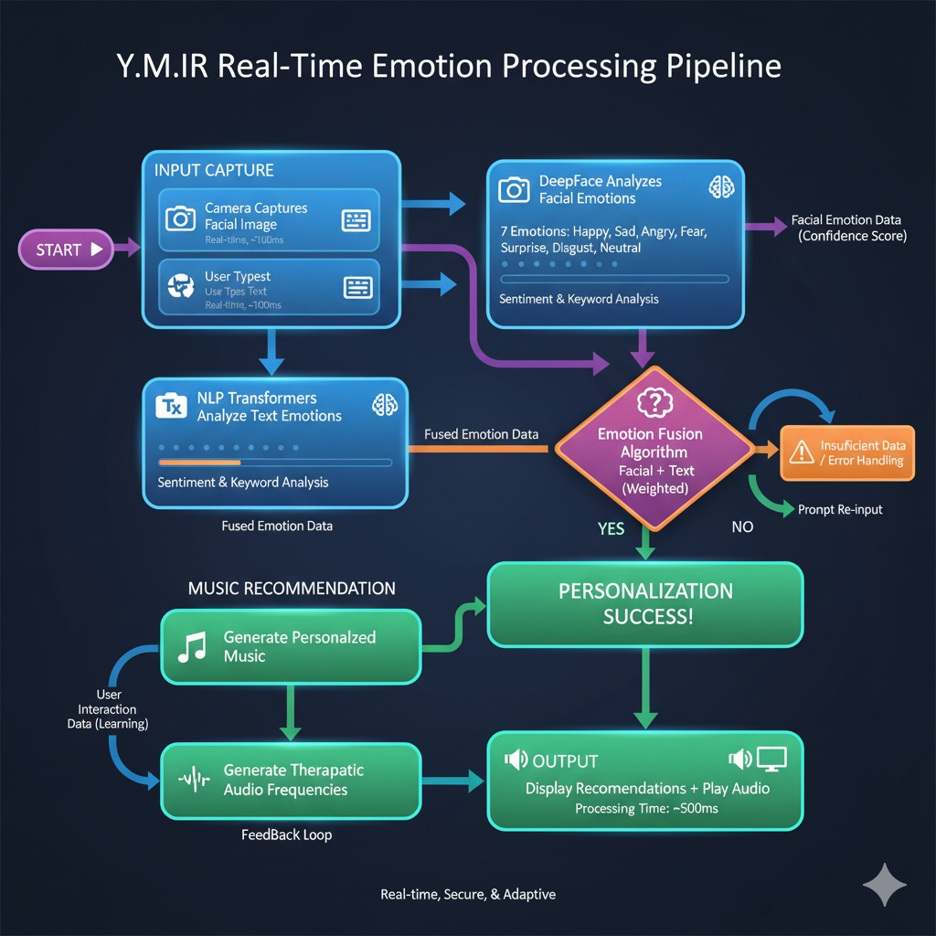
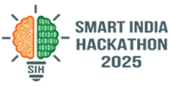
Y.M.I.R.
Yielding Melodies for Internal Restoration
An AI-powered mental health and wellness platform combining emotion detection, music therapy, binaural/isochronic beats, meditation, journaling, and community support.
@SIH Idea submission
2

Slide 3
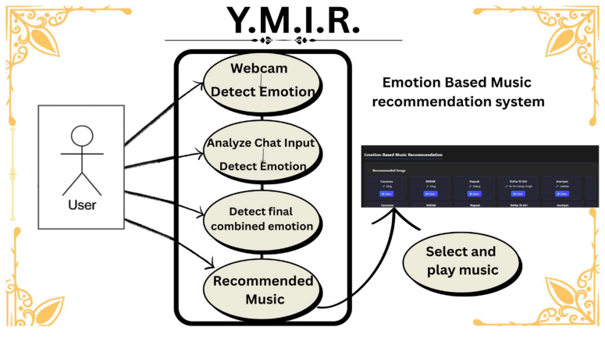
TECHNICAL CONTRIBUTION
TECH STACK
Frontend: HTML, Tailwind CSS, JavaScript
Backend: Flask (Python), SQLAlchemy (SQLite for dev, scalable to cloud DB)
AI/ML: DeepFace (CV), Transformers (NLP), Fusion Algorithm, Recommendation Engine
Experimental Section: Binaural & Isochronic Beats Generated using soundfile & simpleaudio
Database: Firebase Firestore, SQLite
SEQUENCE DIAGRAM
@SIH Idea submission
3

Slide 4
FEASIBILITY & VIABILITY
TECHNICAL FEASIBILITY
MARKET POTENTIAL
VIABILITY
Growing demand for digital mental health solutions
Service-based subscription model
Institutional adoption (corporates, universities)
Financially sustainable through recurring revenue
Minimal manual intervention post-deployment
Uses proven AI & web technologies
Cloud-ready deployment
Regular updates of models & datasets
POTENTIAL CHALLENGES:
STRATEGIES FOR OVERCOMING:
Regular fine-tuning with new, high-quality data, and continuous music scraping as well as user surveys for further improvement
Robust cloud infrastructure for seamless scale and optimal performance
Advanced encryption and fully automated updates for enhanced security
Model accuracy & scalability
Data privacy & security
Continuous maintenance
@SIH Idea submission
4

Slide 5
NOVELTY
AI-driven Music Recommendation & Therapy
Provides personalized emotional healing through intelligent music curation and adaptive AI therapy, going far beyond simple manual song selection (like Spotify).
Binaural Beats: Uses headphone-based dual-frequency tones that synchronize brainwaves, helping users achieve states of deep relaxation, focus, or stress relief.
Isochronic Beats: Employs rhythmic single-tone pulses audible without headphones, designed to naturally entrain the brain for improved calmness, concentration, and emotional balance.
Experimental Beats for ‘Brain Entrainment’
@SIH Idea submission
5

Slide 6
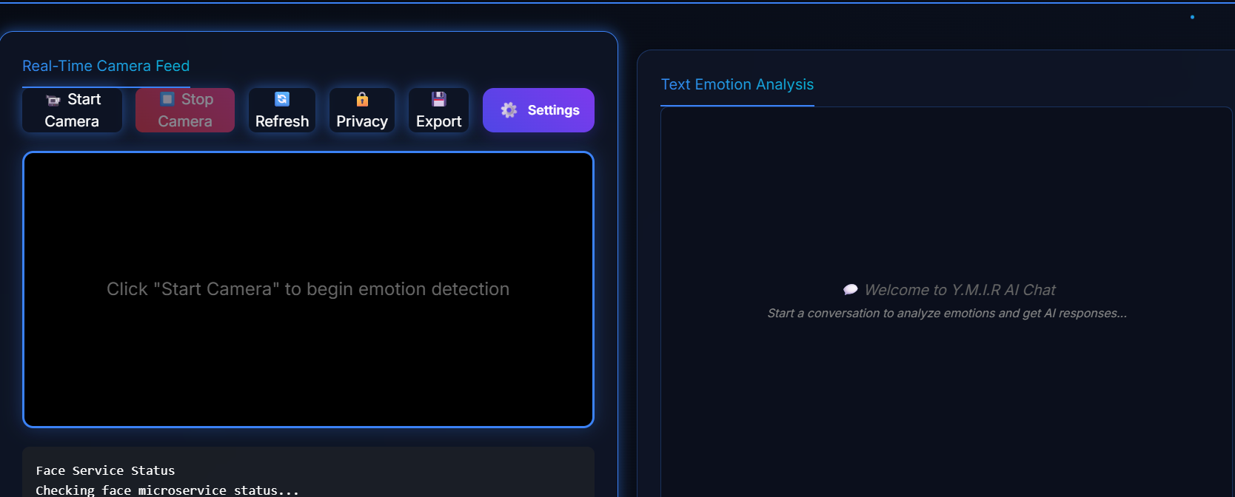
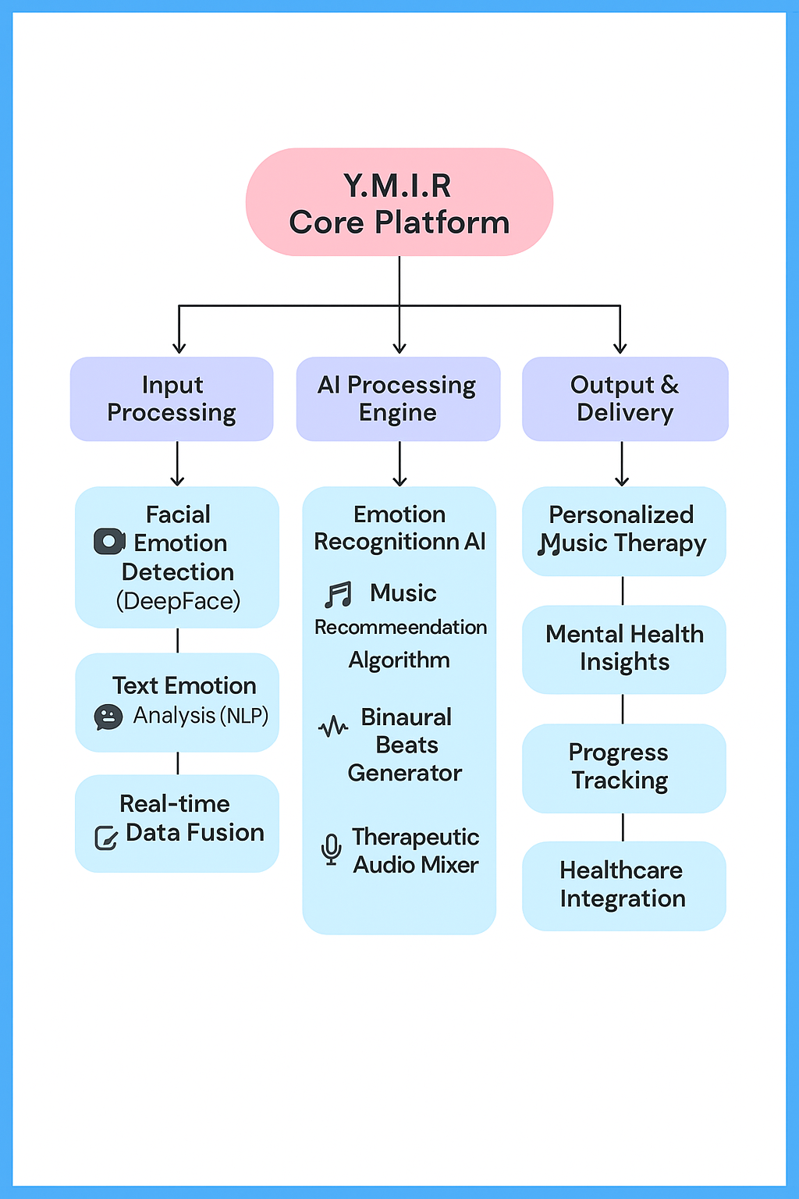
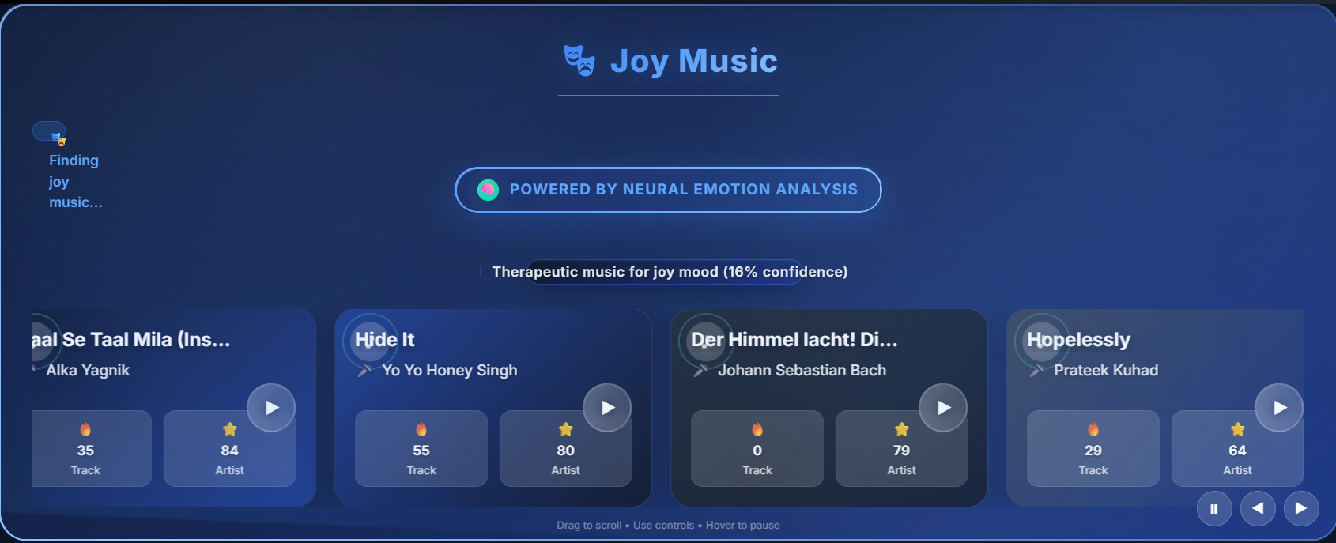
GUI IMPLEMENTATION
1
Easy to use GUI
2
Check all Recommendation based on Emotions
@SIH Idea submission
6

Slide 7
FUTURE SCOPE
AI-based Movie Recommendation & Therapy
Movie recommendation system that analyzes your preferences and viewing habits to suggest personalized films from IMDB. It delivers smarter, more engaging entertainment by matching content to your unique tastes.
Creating immersive online soft gaming sessions enhanced with AI-generated adaptive background music for a next-level, stress-free gaming experience. This platform combines casual gameplay with dynamic soundscapes, shaping the future of interactive entertainment.
Online Soft Gaming Sessions with AI Background Music
@SIH Idea submission
7

Slide 8
REFERENCES
Umbrello, Michele, et al. "Music therapy reduces stress and anxiety in critically ill patients: a systematic review of randomized clinical trials." Minerva anestesiologica 85.8 (2019): 886-898.
Music therapy reduces stress and anxiety in critically ill patients: a systematic review of randomized clinical trials
Ingendoh, Ruth Maria, Ella S. Posny, and Angela Heine. "Binaural beats to entrain the brain? A systematic review of the effects of binaural beat stimulation on brain oscillatory activity, and the implications for psychological research and intervention." PloS one 18.5 (2023): e0286023.
Binaural beats to entrain the brain? A systematic review of the effects of binaural beat stimulation on brain oscillatory activity, and the implications for psychological research and intervention | PLOS One
Reedijk, Susan A., Anne Bolders, and Bernhard Hommel. "The impact of binaural beats on creativity." Frontiers in human neuroscience 7 (2013): 69795.
The impact of binaural beats on creativity
Baseanu, Ionut Cristian Cozmin, et al. "The Efficiency of Binaural Beats on Anxiety and Depression—A Systematic Review." Applied Sciences 14.13 (2024): 5675.
The Efficiency of Binaural Beats on Anxiety and Depression—A Systematic Review
Aparecido-Kanzler, Sandro, Francisco J. Cidral-Filho, and Rui D. Prediger. "Effects of binaural beats and isochronic tones on brain wave modulation: Literature review." Revista mexicana de neurociencia 22.6 (2021): 238-247.
Effects of binaural beats and isochronic tones on brain wave modulation: Literature review
@SIH Idea submission
8

